Slide 1
4CCS1ISE – Final SGT
Testing
Wonjoon Seol (wonjoon.seol@kcl.ac.uk) 01/03/19

Slide 2
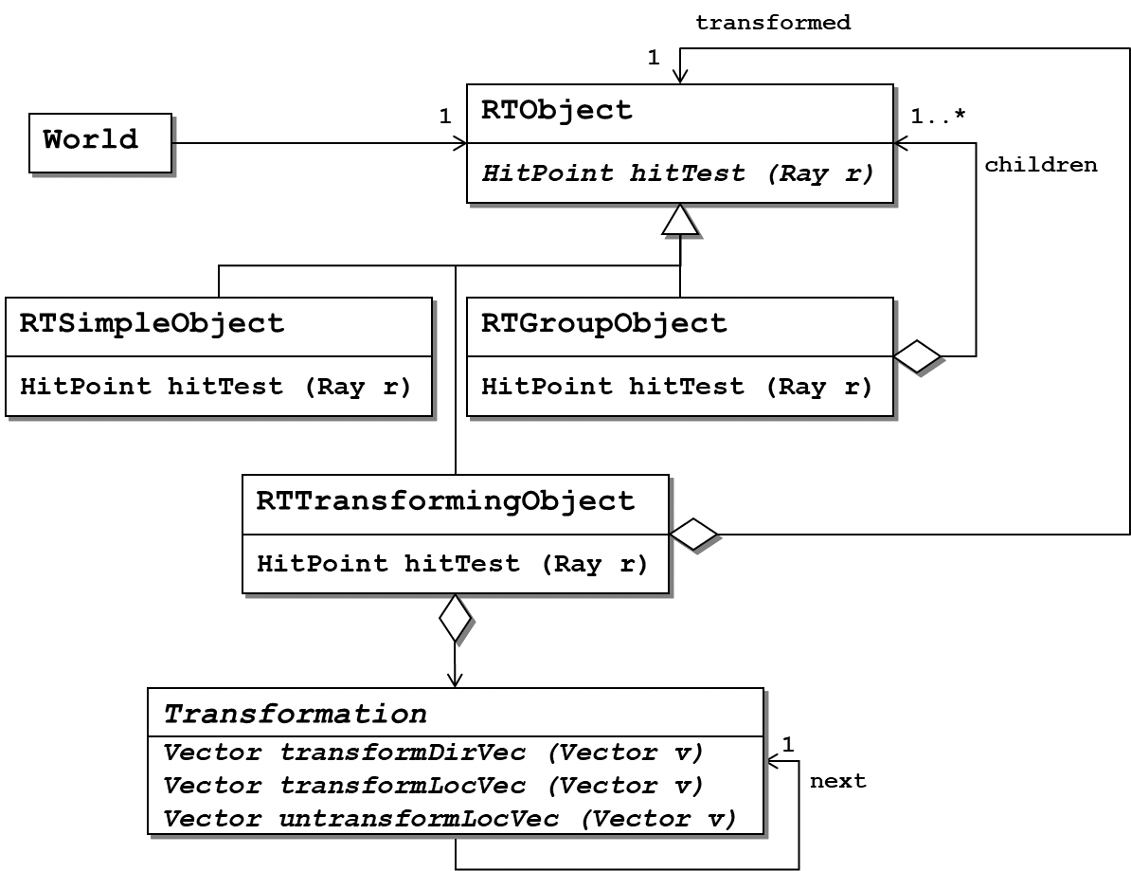
Task 1 – Testing Ray Tracer
10-20
Define an overall test strategy for Ray tracer:
Raytracer should be able to accurately present scenes constructed from basic three-dimensional geometric shapes including support for properties such as reflectivity, colour and different materials.
Rendering a single 400x600 image for a scene of average complexity should not take longer than 5s.
Hint: Focus on whether a particular testing should use black-box or white-box approach / can be automated or not.
Notes:
What would be the right testing approach for each kind of test
Which tests can you automate, which ones are more difficult to automate (and why)

Slide 3
Task 1 - Group solutions
20-23
Please share with the class your solutions

Slide 4
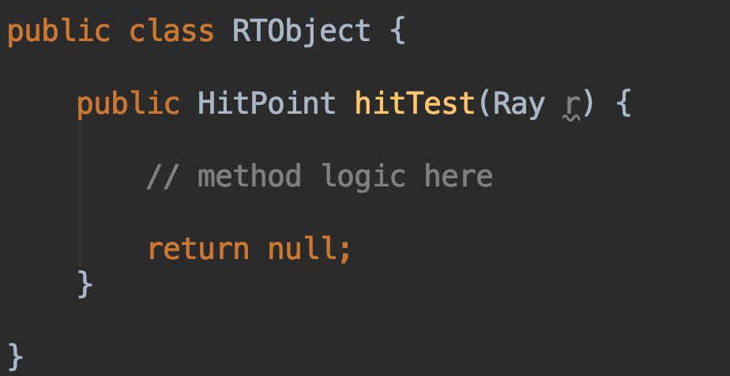
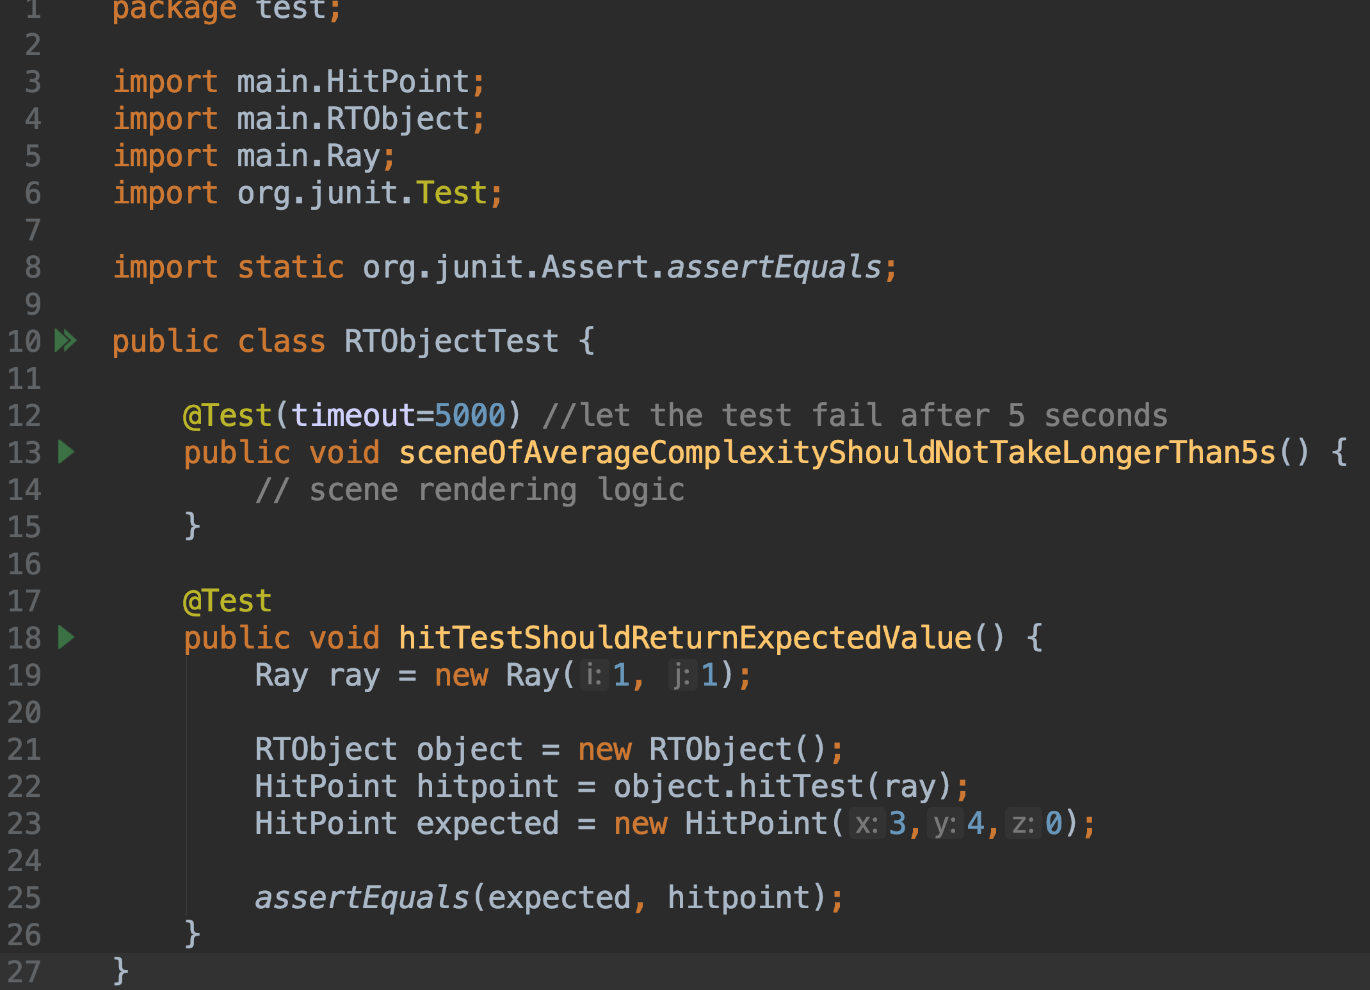
Task 1 – Unit testing
24 - 26
Test complex individual functionalities
(e.g. operations computing whether a ray hits an object or for transforming ray vectors)
Should unit testing use black box approach or white box approach? / Is it easy to automate?
Original Method
Junit
Invoking method
Expected Value
Two should be equal
Notes:
Formal testing with respect to user needs, requirements, and business processes conducted to determine whether or not a system satisfies the acceptance criteria and to enable the user, customers or other authorized entity to determine whether or not to accept the system.

Slide 5
Task 1 – Integration & System testing
26 - 28
Integration & System testing
Integrated modules/software are tested
Based on simple standardised scenes and hit point calculation for these, possibly including pre- transformation
The specific sample scenes are probably better chosen in a white-box approach considering knowledge of the above design and ensuring different relevant combinations of the classes and objects are covered by appropriate tests.
Easy to automate and should be automated so that regression tests can be run for any new change to the software.
Rendering a single 400x600 image for a scene of average complexity should not take longer than 5s.
Notes:
Formal testing with respect to user needs, requirements, and business processes conducted to determine whether or not a system satisfies the acceptance criteria and to enable the user, customers or other authorized entity to determine whether or not to accept the system.

Slide 6
Task 1 – Acceptance testing
30
Customers test a system to decide whether or not it is ready to be accepted from the system developers and deployed in the customer environment.
Check that given scene specifications are indeed correctly rendered.
Difficult to automate
Notes:
Formal testing with respect to user needs, requirements, and business processes conducted to determine whether or not a system satisfies the acceptance criteria and to enable the user, customers or other authorized entity to determine whether or not to accept the system.

Slide 7
Task 2 – Report Structure
30-40
Devise a structure for a report on the raytracing example.
What structure should the final report have?
What sections should the report contain?
What sub-sections might they have in each one?
Write a sentence summarising what each (sub)section will say.

Slide 8
Task 2 - Group Solutions
40-45
Please share with the class your solutions

Slide 9
Task 2 - Solution
45-55
The report should contain overarching narratives
Diagrams - there should always be some descriptive and explanatory text to go with them
Focus on the key decisions represented by the diagrams and justify any assumptions you made.
Example : My 2nd year OSD coursework (Now 4CCS1ISE module)

